Slide 1
AGENDA
Core Tech Project 2
Unlock your Dreams…
Let us take care of your travel adventures. Whether you’re a one person travel agency or multilingual conglomerate. We’ll be there to create an optimal IT-solution for your proposals.
1
Work Flow
Helpful tools
Techniques
2
Challenges
Each figured out their own
solutions for given tasks
3
Graphic Design
Consistent design throughout the project
4
HTML/CSS Structure
Media queries
Trouble shooting

Slide 2
Mission description
01
Problem Analysis
Strength & Weaknesses
Content requirements
Optimal solutions for ideas (Git, branches, etc.)
Collecting & validation of alternative solutions due to time constraint (3 days)
02
HTML/CSS/JS Design
Frequent meetings & tight feedback loops
Status updates seen via Github
Setting up proper communication patterns for troubleshooting.
03
Merging
Version Control Systems (Github)
Fixing additional bugs
All team members are responsible to take extra care about their commits.

Slide 3
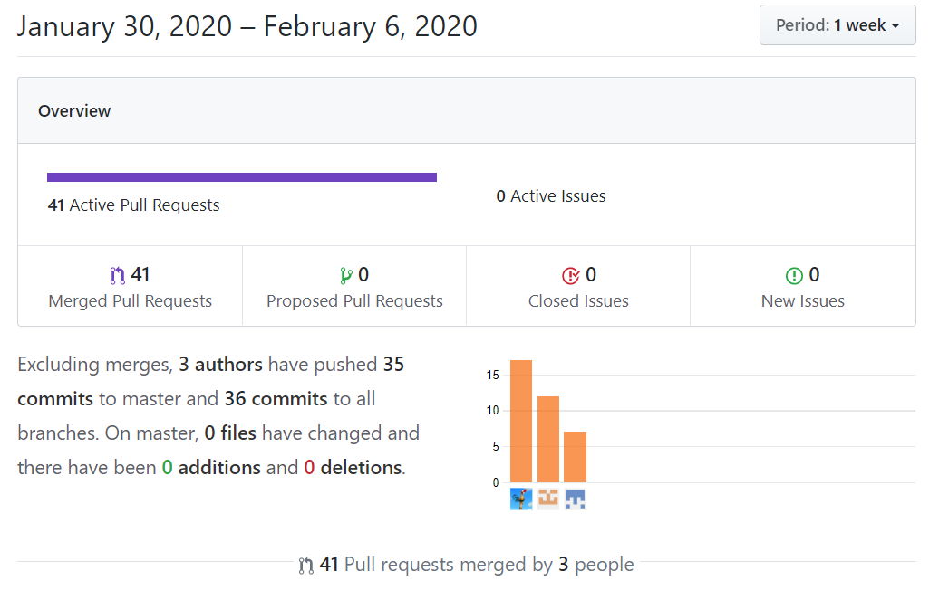
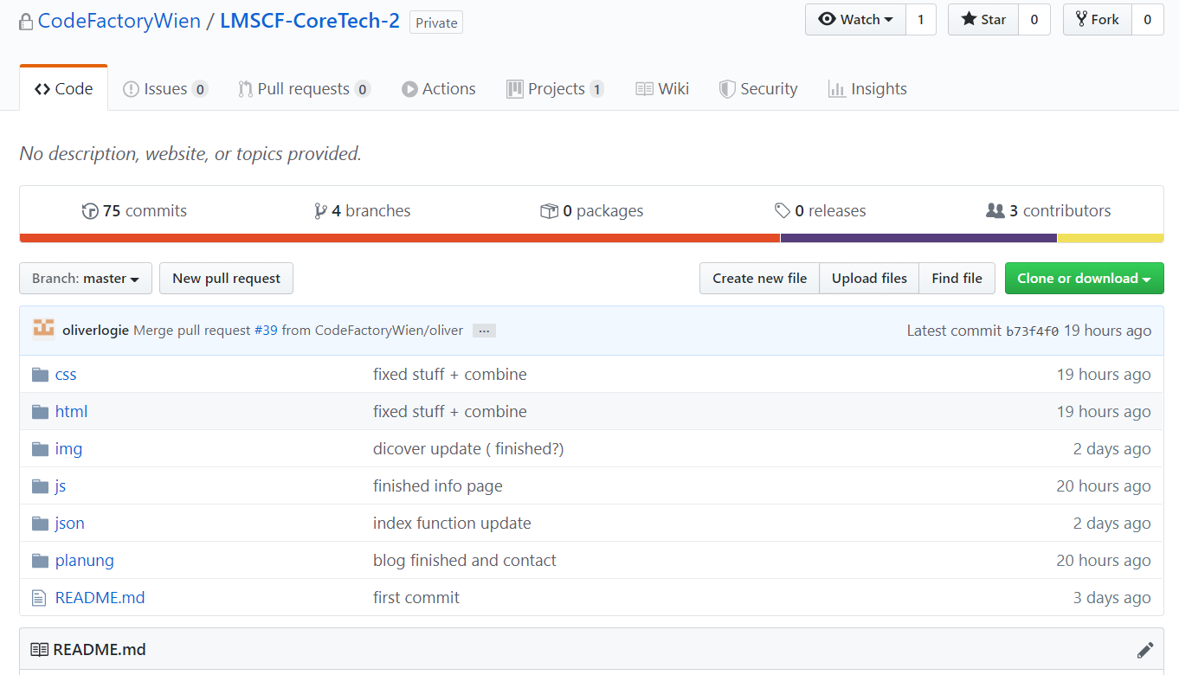
General
index.html
home.html
activities.html
discovery.html
infos.html
contact.html

Slide 4

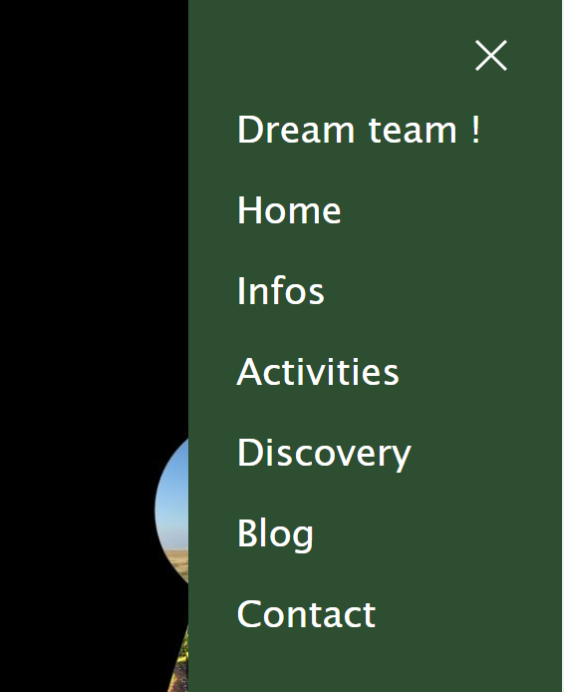
Oliver – Nav/Footer
Step No. 1 …

Slide 5
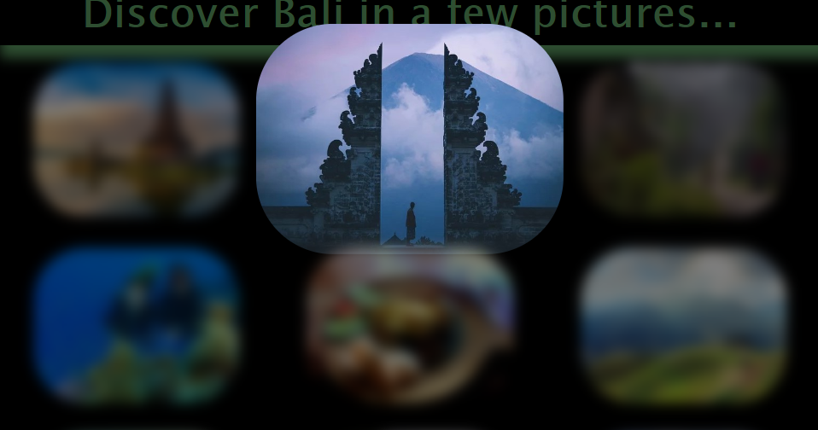
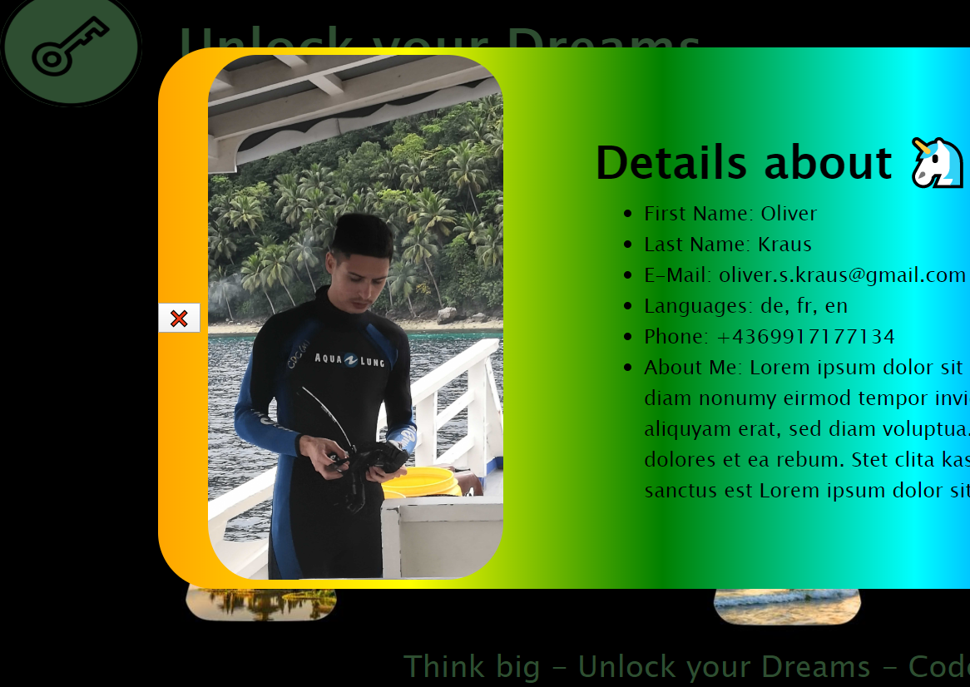
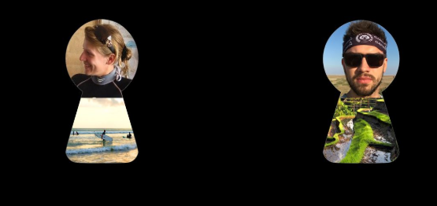
Lisa
JS DIV Generator

Slide 6
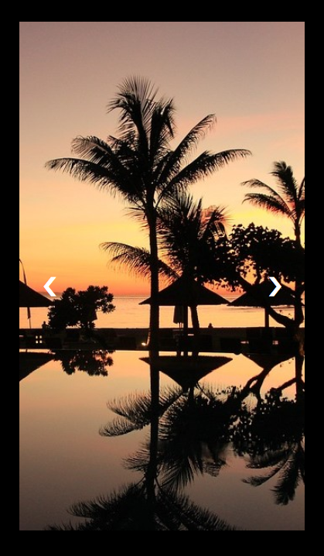
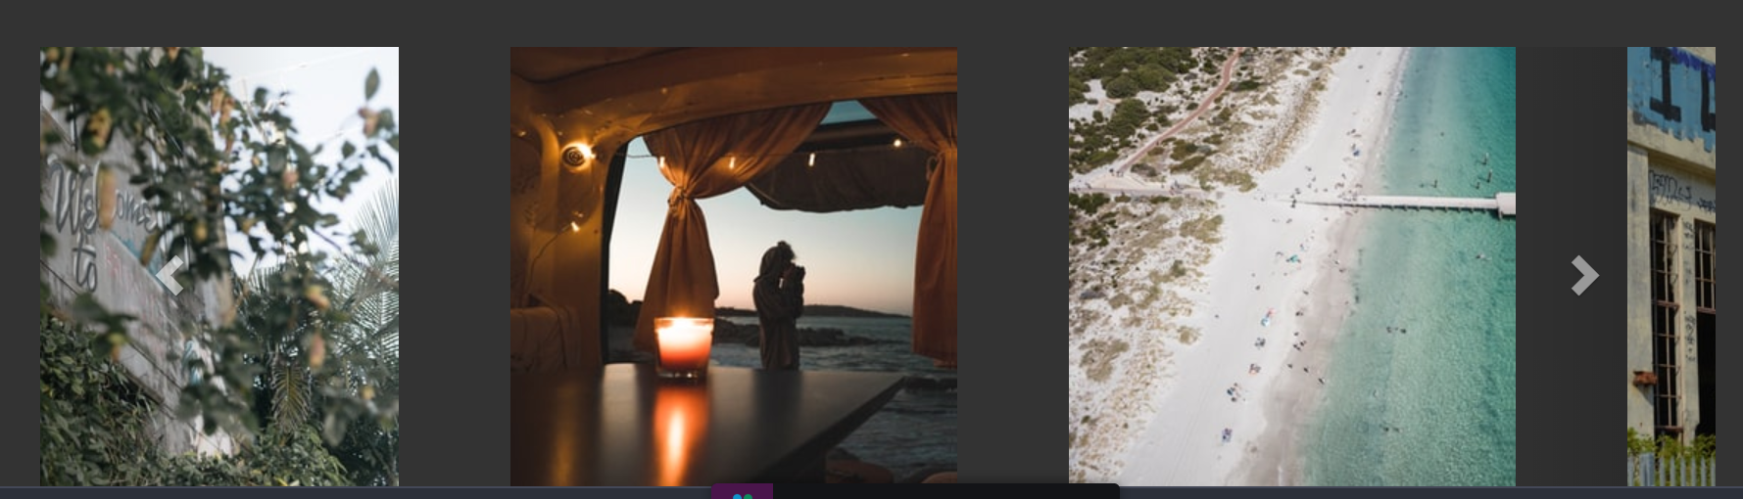
Vinzenz
Carousel / Slider
Step No. 3 …

Slide 7
Unsolved problems.:
Responsive font-size (VW as ref & everything else in rem)
Using Mixin to avoid redundant code
Layout issues (queries & responsive webdesign)
Any questions?

